Slide 1
MS FLOW + Logic Apps + PowerApps Possibilities

Slide 2
1. Automated Mail Alerts Logic Apps + Data in SQL database

Slide 3

Tools Data Flow Logic App

Slide 4

Logic App enables the user to pick up context-aware data and trigger a series of dependent actions
Azure Logic Apps is a cloud service that helps you schedule, automate, and orchestrate tasks, business processes, and workflows when you need to integrate apps, data, systems, and services across enterprises or organizations. Logic Apps simplifies how you design and build scalable solutions

Slide 5
Tools Data Flow Logic App

Slide 6


The Logic App picks up filtered data from SQL and fills an email template and populates attachments and sends an email
MS SQL Server contains data in the form of various tables at various levels
Logic App goes through the SQL table, picking up emails of the intended recipients from the table and sends various kinds of predefined mails based on a flag column
Logic App enables the email to be dynamic. The template can be fixed and the data inside the mail can contain user specific data in the form of tables, etc. Attachments can also be included in the mail which is populated dynamically.
The business users receives email with an attachment and email body, both of which are dynamic. For example, the user can receive a warning/alert/update mail which contains data specific to the user
** The email template remains unchanged, ready to be used for the next run

Slide 7
Tools Data Flow Logic App

Slide 8
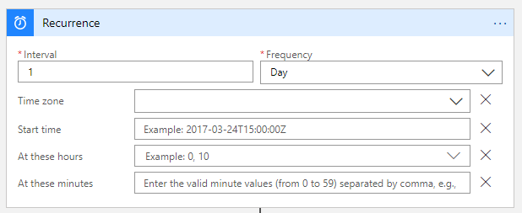

The Logic App can be triggered intelligently based on other actions or can be set on recurrence
The Logic App can be set to be triggered at certain time intervals. For example: If a business alert/update is scheduled to be sent to the user as a daily cadence, the recurrence can be set accordingly.
Alternatively, another action can trigger a workflow.
Lets consider a situation in which a pipeline updates the data in SQL.
The Logic App can be configured to run as soon as the pipeline finishes running and the refreshed data is available

Slide 9
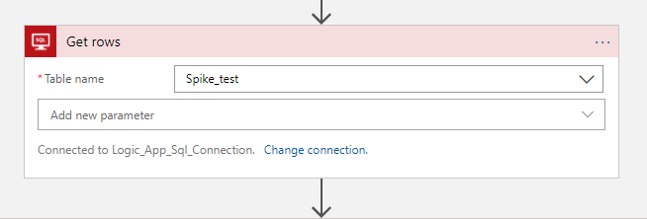
The Logic App can get data from SQL tables with the SQL connector
The SQL Server connector in Logic Apps can fetch all the rows of a SQL table.
For example: In the screenshot, all the rows of the table ‘Spike_test’ is being imported
In this example, we are sending out emails to the users based on a spike flag. If there is a cost spike, the user should be notified how much of a spike there was, along with some other KPIs.
If there was no spike in the cost, then the user should receive a ‘congratulatory’ mail along with a few KPIs.
This being understood, the current table ‘Spike_test’ contains data at a user level. So every row contains certain KPI values/descriptors at a user level

Slide 10
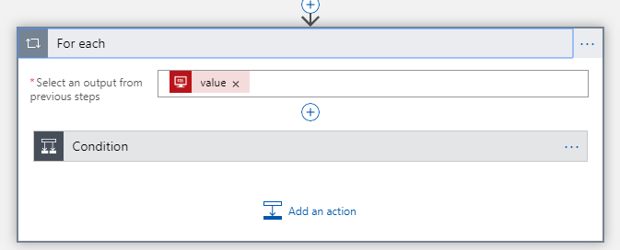
The LogicApp can perform actions ‘for each’ element in the preceding step
Actions can be performed in loop for each of the elements present in the SQL table (previous step). For example, the ‘for each’ connector loop goes inside each and every row of the table and can perform a predefined action for each of those row. Lets say, it can send an email to all the users present in the table (as the table is at an user level) and the ‘for each’ loop evaluates each row and sends the email for the users.
If the table is at an user level, and there are n number of rows, the logic app can send n emails to the respective users.
Also note that the email ids are picked up dynamically from the table by the logic app. As soon as the table updates with the new list of user, the emails will be sent to the new list.

Slide 11
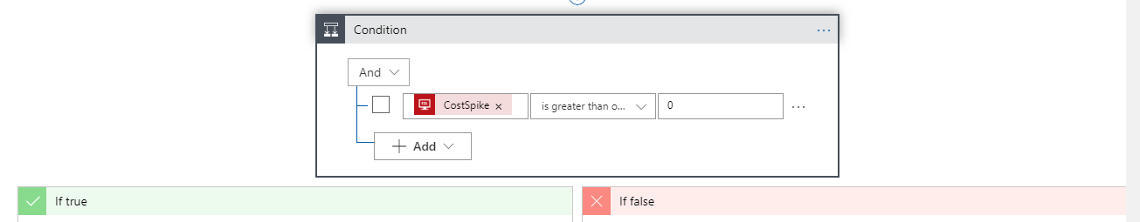
The Logic app can evaluate conditional statements based on the data
The Logic App can read into the data (in this context, the SQL table) and the workflow can be split into branches via a logical condition.
For example: We have a SQL table at a user level which also contains various KPIs as columns. One of those columns give me the KPI ‘CostSpike’
Now, using the Logic App, I can send a ‘warning’ mail if the ‘CostSpike is positive, or we can send a ‘congratulatory’ mail if the CostSpike is 0 or negative.
The logical operator also enable to use a combination of AND/OR conditions to branch the workflow into the ‘Yes/No’ stream

Slide 12
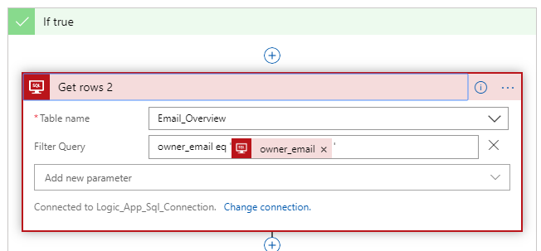
The Logic app can fetch data from other tables by doing a primary key match for the relevant user
Now lets consider a situation in which the CostSpike is positive. This means that there is a cause for concern. Hence, we need to send a warning mail with some granular/detailed information.
This detailed data was not available in the original SQL table. Hence, we need to fetch the relevant rows from a different SQL table(which contains granular data). The relevant data consists of rows which have been filtered dynamically by doing a primary key match.
For example: Lets say the ‘for each’ loop (previous step) looks into a particular row and the email it finds is ‘xyz@effem.com’. So now, it will look into the second table which contains the data at a more granular level and does a primary key match to filter only the rows of ‘xyz@effem.com’
In the screenshot above, the filter query dynamically filters for the ‘owner_email’ which is being considered in the ‘for each’ loop right now

Slide 13
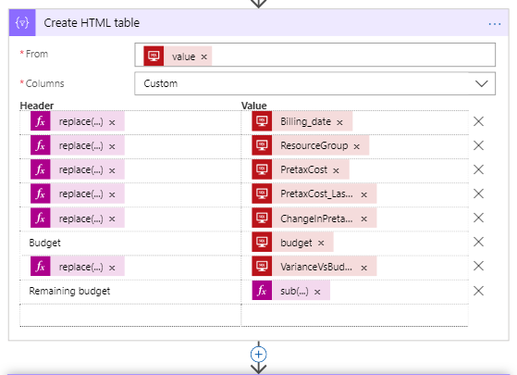
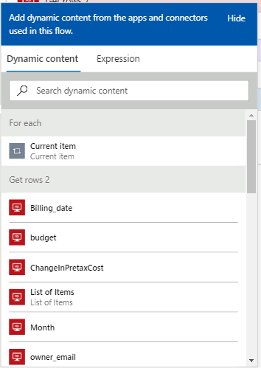
The Logic app can create dynamic HTML table objects from the filtered content of previous steps
Once the rows have been filtered according the user email, we can create an HTML table object from the filtered rows. The inputs in the ‘CreateHTML table’ can be picked up from the outputs of the previous steps (below screenshot for reference)
The headers can be modified using string operations and the value can be inserted dynamically from the outputs of the previous step

Slide 14
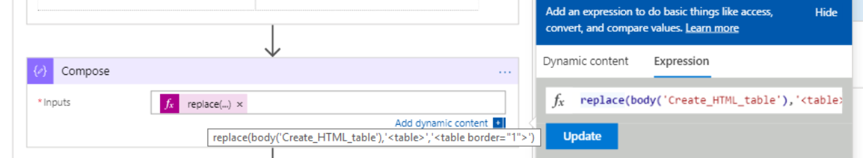
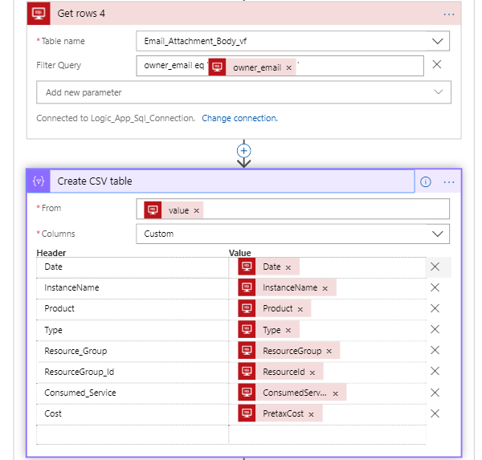
The Logic app can transform the data into various formats
The HTML object is now converted into a physical table with table borders. This entire object can be inserted into the body of the mail
Similarly, the filtered rows from the SQL can be transformed into a CSV file, which can be sent as an attachment along with the mail. The header can be customized and the values can be inserted dynamically.

Slide 15
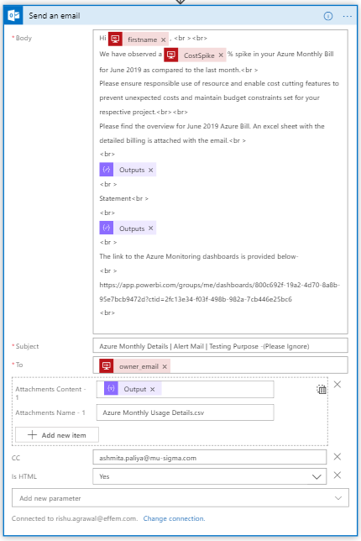
The Logic app can send the email with the gathered dynamic content
Finally, all the gathered content can be sent to the user in the form of an email.
The entire content of the email can be dynamic.
Usually, an email template is prepared in which we insert the dynamic content.
The body of the mail: The body of the mail can consist of static texts, where dynamic content can be inserted. For example, the ‘Hi _____’ field can be populated dynamically by using the ‘firstname’ variable from the SQL table. The ‘Costspike’ can also be mentioned in the body of the mail
Subject of the email: The subject of the email can be static or it can include dynamic content such as the ‘CostSpike’
To: The email will be dynamically directed to the user relevant to the row in which the ‘For each’ loop is in. As in the previous example, if the ‘For each’ loop is in a row for ‘xyz@effem.com’, the value for ‘owner_email’ becomes ‘xyz@effem.com’. As explained before, if the level of the table is user and there are n numbers of users in the SQL table, then n number of emails will be sent in total (1 each to the users)
Attachments: The .CSV file which was created in the previous step can now be attached in the email. Please note that the .CSV file is being populated dynamically and each user will get an unique .CSV file, which contains content relevant to him/her
*Please note that the IsHTML parameter is set to ‘yes’ as the body contains HTML content. Hence, standard HTML tags are being used in the body for formatting the body of the email.

Slide 16
2. Broadcast Functionalities PowerApp + Logic App

Slide 17
Tools Data Flow Screenshots

Slide 18

PowerApps + Logic App enables the user to pass context-aware data to trigger a series of dependent actions
PowerApps is a suite of apps, services, connectors and data platform that provides a rapid application development environment to build custom apps for business needs. Using PowerApps, one can quickly build custom business apps that connect to the business data stored either in the underlying data platform or in various online and on-premises data sources.
Azure Logic Apps is a cloud service that helps you schedule, automate, and orchestrate tasks, business processes, and workflows when you need to integrate apps, data, systems, and services across enterprises or organizations. Logic Apps simplifies how you design and build scalable solutions

Slide 19
Tools Data Flow Screenshots

Slide 20



The PowerApp accepts inputs and triggers a Logic App flow to populate the .docx document template and send an email
A blank .docx template file is stored in a SharePoint/OneDrive location
The custom inputs which are fed through the PowerApp is filled in the template file and a temporary version of the word file is created.
The temporary file (completely filled with text) is sent to the emails which the user inputs in the app
The business users receives email with an attachment of the filled document
** The master template file remains unchanged, ready to be used for the next run

Slide 21
Tools Data Flow Screenshots

Slide 22
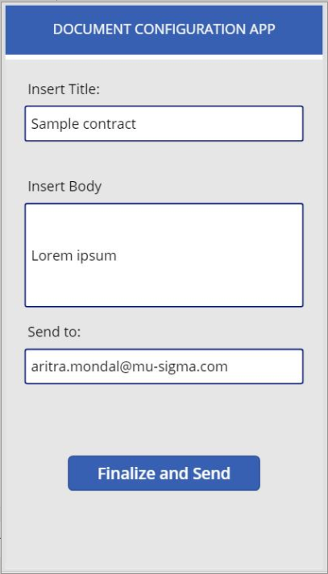
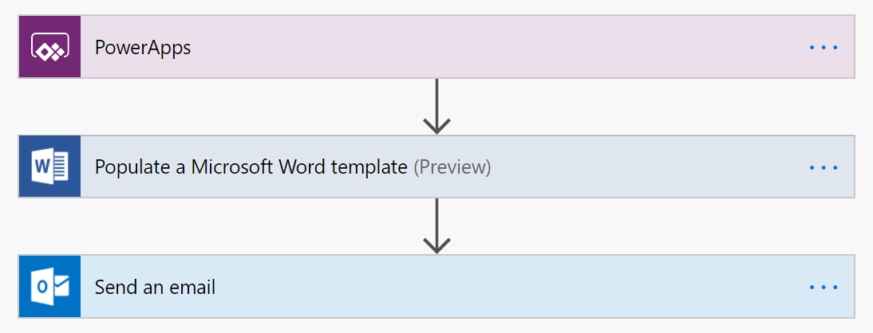
The user fills in the desired input in the PowerApp
Logic App work flow
PowerApp interface

Slide 23
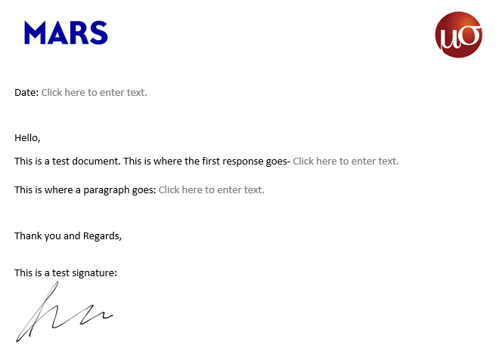
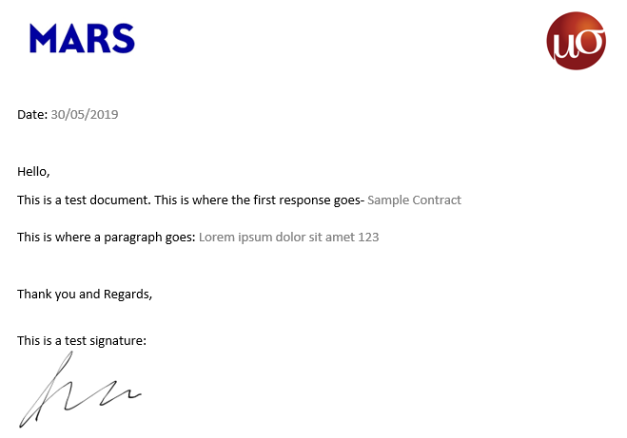
The Logic App workflow fills the input text in the template and sends an email
Document template
The filled document the user receives

Slide 24
3. Sending blob content via email Logic App

Slide 25
Tools Data Flow Logic App

Slide 26
Logic App enables the user to fetch context-aware data to trigger a series of dependent actions
Azure Logic Apps is a cloud service that helps you schedule, automate, and orchestrate tasks, business processes, and workflows when you need to integrate apps, data, systems, and services across enterprises or organizations. Logic Apps simplifies how you design and build scalable solutions

Slide 27
Tools Data Flow Logic App

Slide 28

An email can be sent to users which picks up the relevant attachments from a blob storage
Azure blob storage contains n number of files relevant to different users. The filename is the same as the email of the user (which is contained in a SQL table, maybe)
The Logic App picks up the relevant attachment from the blob folder
The file is attached in an email and sent to the relevant user
The business users receives email with an attachment
** The trigger can be modified to start the workflow as soon as there is a change in blob, a mail is sent out with the file as an attachment

Slide 29
Tools Data Flow Logic App

Slide 30
The Logic App can be triggered intelligently based on other actions or can be set on recurrence
The Logic App can be set to be triggered at certain time intervals. For example: If a business alert/update is scheduled to be sent to the user as a daily cadence, the recurrence can be set accordingly.
Alternatively, another action can trigger a workflow.
Lets consider a situation in which a pipeline updates the data in SQL.
The LogicApp can be configured to run as soon as the pipeline finishes running and the refreshed data is available

Slide 31
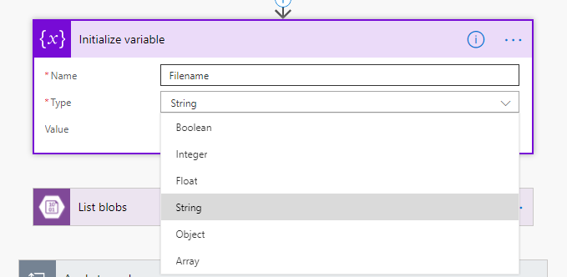
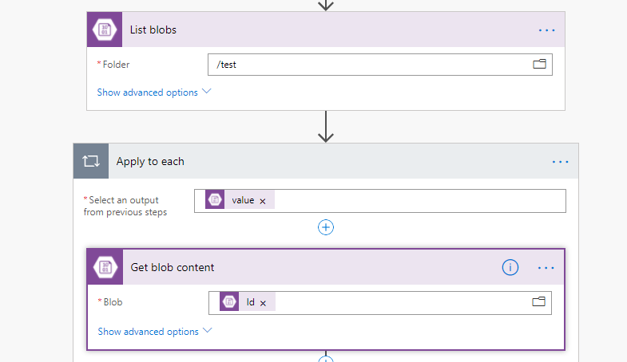
Variable can be initialized in Logic App which can be various types
A variable can hold the dynamic values which are the result of various actions.
The variables can be various types- Boolean, Integer, Float, String, Array, Object, etc.
Furthermore, there are two options to modify the variable:
We can append to the variable
We can overwrite the value of the variable
We can also set increment/decrement in an integer variable. This can be used to count instances of an action.
The files inside a blob can be listed by using the ‘List Blob’ connector.
We use the ‘Apply to each’ connector again.
We get the file contents by going in a loop where we cover all the ‘Id’ from the output of the list blobs. So, in summary, the ‘List blobs’ connector fetches all the file details and we fetch the file content by running a loop for all of those ‘Ids’ and use the ‘Get blob content’ connector
Please note that in this example, the blob stores the .png files with the name being the email id of the user. Hence, the file for the user ‘xyz@effem.com’ will be named as ‘xyz@effem.com.png’ inside the blob. This is the naming convention followed. This enables us to dynamically pick up content for the relevant user

Slide 32
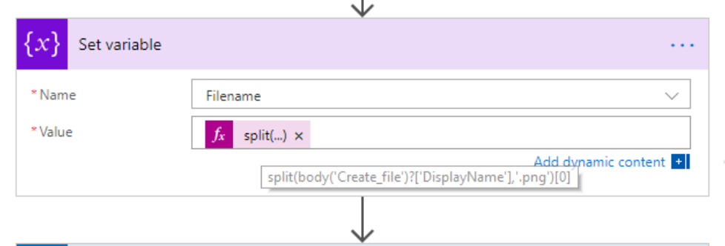
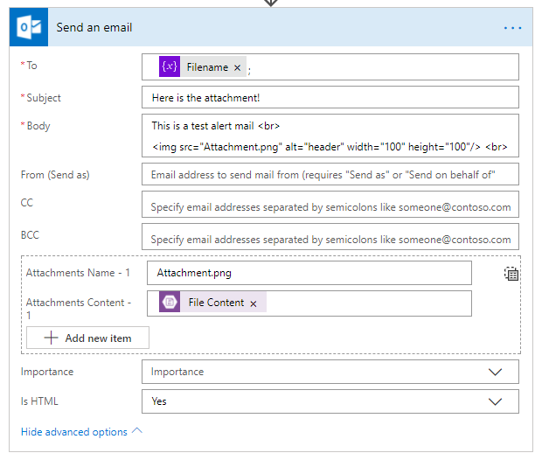
Variable can be initialized in Logic App which can be various types
Now that we have picked up the contents of a specific file, we need to extract the email from the filename.
We need to extract ‘xyz@effem.com’ and we use a split string operation for this. We split the string ‘xyz@effem.com.png’ into two parts and pick up the first part i.e. ‘xyz@effem.com’
We now have the dynamic email id ready inside the loop.
We are now ready to send out the mail with the email id as the dynamic content ‘Filename’. This is actually the value of the variable which is now set as the extracted part of the filename.
The subject and the body can contain dynamic content as well.
The body can contain HTML content and formatted according to HTML tags
The attachment is being picked up dynamically. The file is being picked up from the blob location where the filename is same as the email id this email is being sent to.
The attachment can be named dynamically or can carry a static name.

Slide 33
4. Embedding images in email body sent via Logic App

Slide 34
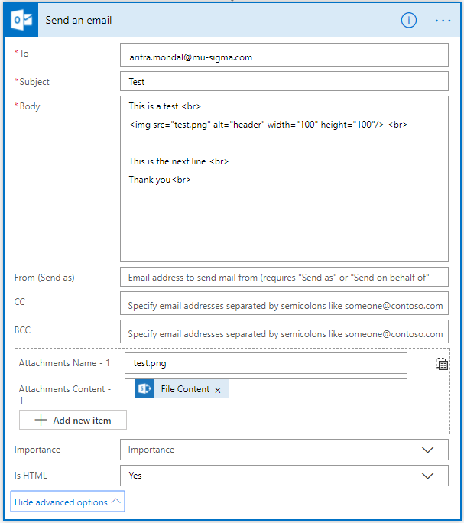

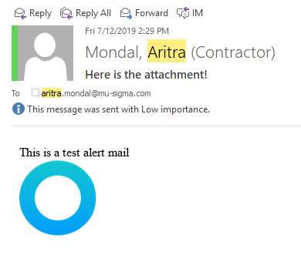
Embedding images in the body of the email
Images can be displayed in the body of the mail by referencing the attachment in the mail body.
Apparently, Outlook forbids an image to be picked up from Sharepoint/Onedrive for business and displayed directly in the body of the mail.
Hence, add it in the Logic App as an attachment of the mail and then reference it in the body of the mail.
There is a separate limitation where Outlook may be configured to not display images in the body. Please go through this link, in case - https://support.microsoft.com/en-in/help/2779191/inline-images-may-display-as-a-red-x-in-outlook
Usecase: Lets say that a databricks notebook renders KPI graphs for 10 users at an user level. The images are stored in a blob location. Then, A logic app can dynamically pick up the images from the blob location and attach it to the mail. Then, the graphs can be displayed in the email body itself.
Hence, the alert email can contain dynamic visualizations and every email sent will be unique according to the user.

Slide 35
5. Automating the trigger for a flow Logic App

Slide 36
Tools Data Flow Screenshots

Slide 37

PowerApps + Logic App enables the user to pass context-aware data to trigger a series of dependent actions
Microsoft SQL Server is a relational database management system developed by Microsoft. As a database server, it is a software product with the primary function of storing and retrieving data as requested by other software applications—which may run either on the same computer or on another computer across a network
Azure Logic Apps is a cloud service that helps you schedule, automate, and orchestrate tasks, business processes, and workflows when you need to integrate apps, data, systems, and services across enterprises or organizations. Logic Apps simplifies how you design and build scalable solutions

Slide 38
Tools Data Flow Screenshots

Slide 39



A Logic App can be triggered as soon as there is a modification in a SQL table
Azure Data Factory Pipeline caries out an end-to-end workflow. For example, a pipeline is automatically triggered when the Max(Date Column)=Today() i.e. whenever the data for today is available, the pipeline is triggered and it refreshes the dataset
We want to trigger a Logic App as soon as this pipeline run finishes and the latest data is available in the SQL tables. Lets relate this to the previous example in which there is a SQL table at an user level and contains various KPIs. The KPIs update weekly via a pipeline run. Hence, we want to send out an dynamic automated mail which picks up content from the SQL table
To achieve this, the last block of the pipeline writes the latest timestamp in a SQL table whenever the pipeline finishes running.
The Logic App is configured in a way that it is triggered as soon as the SQL table in question is modified.
** The trigger can be modified to start the Logic App. Thereafter, the combination of actions can be anything. The possibilities are endless!

Slide 40
Tools Data Flow Logic App

Slide 41


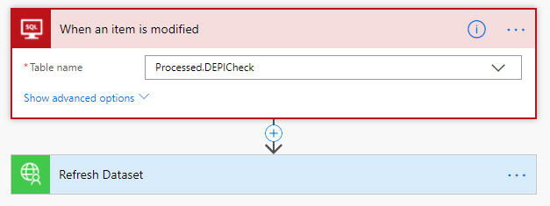
Changes in special tables in SQL can trigger LogicApps
A SQL table is created which contains a single row. The column ‘Today’ is of the type ‘timestamp’. This is a prerequisite for this.
The value of the timestamp keeps changing every time the pipeline runs, and in turn triggers the Logic App.
Now coming to the Logic App, the trigger ‘When an item is modified’ from ‘SQL connectors’ is added.
As a connection is made with the SQL database, all the tables which contain a timestamp column will show up in the dropdown. If there is no timestamp column, the table will not show up in this connector. Hence, timestamp column is a prerequisite.
Now the actions can be set as per requirement. In the screenshot on the right side, the pipeline refreshes the SQL table daily. As soon as the data is refreshed, the pipeline updates the SQL table timestamp as the last step of the pipeline. As soon as the timestamp is changed, the Logic App is triggered and the Power BI dataset refreshes according to the latest data (as the connection is an import connection)

Slide 42
6. Power BI dataset refresh MS Flow Custom Connector

Slide 43
Tools Data Flow MS Flow

Slide 44


Custom connectors can be built in MS Flow and can be used at an org level
Power BI is a business analytics service by Microsoft. It aims to provide interactive visualizations and business intelligence capabilities with an interface simple enough for end users to create their own reports and dashboards
Microsoft Flow is cloud-based software that allows employees to create and automate workflows and tasks across multiple applications and services without help from developers. Automated workflows are called flows. To create a flow, the user specifies what action should take place when a specific event occurs

Slide 45
Tools Data Flow MS Flow

Slide 46
A Power BI import/extract dataset can be triggered as soon as the SQL table is refreshed
Azure Data Factory Pipeline caries out an end-to-end workflow. For example, a pipeline is automatically triggered when the Max(Date Column)=Today() i.e. whenever the data for today is available, the pipeline is triggered and it refreshes the dataset
We want to trigger a MS Flow as soon as this pipeline run finishes and the latest data is available in the SQL tables. Lets relate this to the previous example in which there is a SQL table at an user level and contains various KPIs. The KPIs update weekly via a pipeline run.
The last action of the MS Flow is to trigger the Power BI dataset refresh
The dataset of the power BI report is refreshed and now will be in sync with the SQL table.
The visuals are now refreshed as well, reflecting the latest data
** The custom connector can be published to the entire organization can be used throughout projects

Slide 47
Tools Data Flow MS Flow custom connector

Slide 48
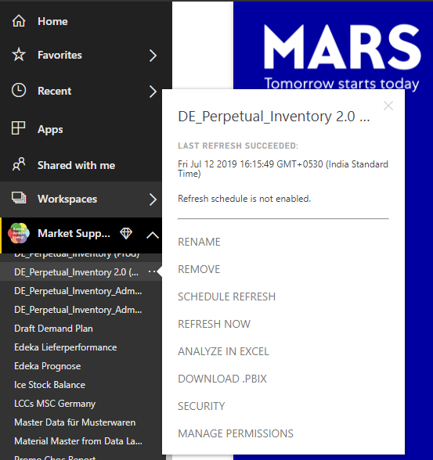
A custom connector can be built in MS Flow which triggers Power BI dataset refresh on-demand
Lets consider that a Power BI report uses an import connection for that data. Hence, an extract is created in Power BI of the SQL table
Refresh cadence- daily
Hence, a pipeline runs everyday to refresh the SQL table, hence, the Power BI extract should refresh daily as well.
For those asking- Why Import? Why not a direct/live query.
Answer- It depends on the use-case. Think of a situation in which the data is refreshed daily. If the data size is considerable, a live query will impact the performance as it will hit the SQL table for every query (even filter operation). Hence, this is not required at all, right?
Next question- Why use a complex connector to trigger the refresh? Why cant we just schedule a refresh? Or why cant the end-user maybe refresh the extract by clicking a button?
Answer- ii) Starting with the second question, it is not expected of the end user to refresh the dataset. He should automatically see the refreshed dataset reflecting in the report. Also, if a Power BI report is shared with the end user, the user just has view access for the underlying dataset. He does not have the option of syncing the extract with the SQL table.
i) Answering the first question, theoretically, a refresh can be scheduled. Think of an example where we know that the data is available by 12:00 PM. So the pipeline starts running at 12:05 maybe and finishes by 12:07 PM. Then the Power BI dataset (extract) refresh can be scheduled for 12:10.
But what if the data was not available at 12:00 PM and only became available at 12:45? The entire flow is broken then. The system will not refresh at all. This system is not a dynamic system.
The system should be- The pipeline starts intelligently as soon as the latest data is available. If the data is not available, then stakeholders should be notified via email. Then as soon as the pipeline runs and the SQL table is updated, the refresh of the Power BI data extract should start.

Slide 49
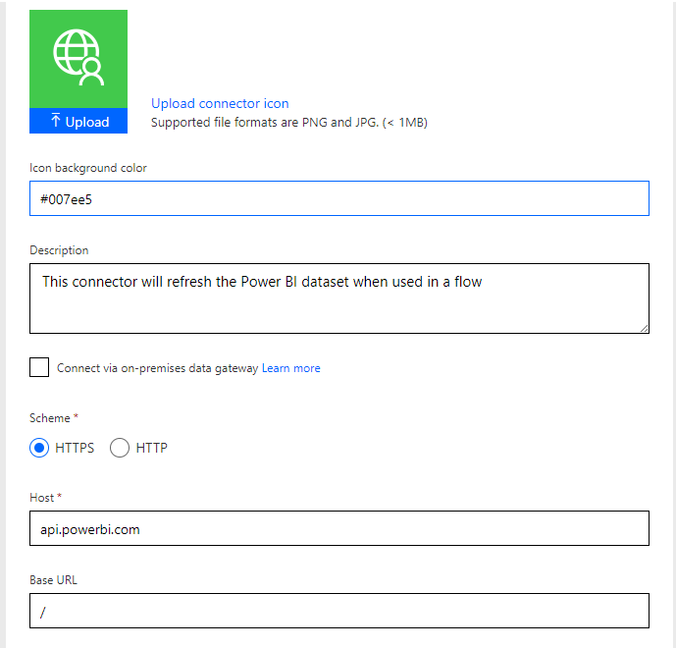
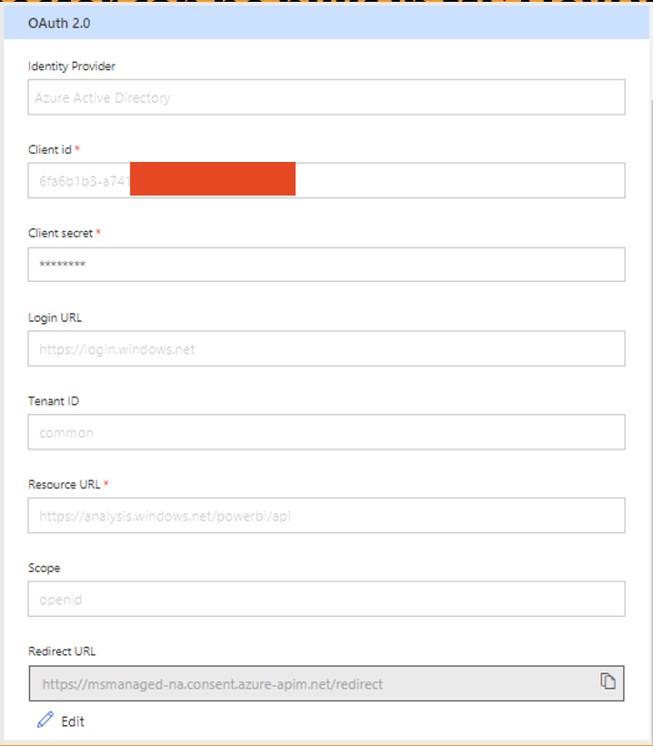
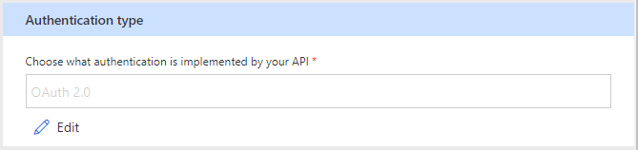
A custom connector can be built in MS Flow which triggers Power BI dataset refresh on-demand
We begin building a custom connector for refresh of power bi datasets.
The custom connector leverages Power BI REST APIs to trigger the refresh. OAuth 2.0 authentication is used for this. It also uses the client id and Client secret of the registered Azure App.
This particular connector refreshes a dataset in a group workspace

Slide 50
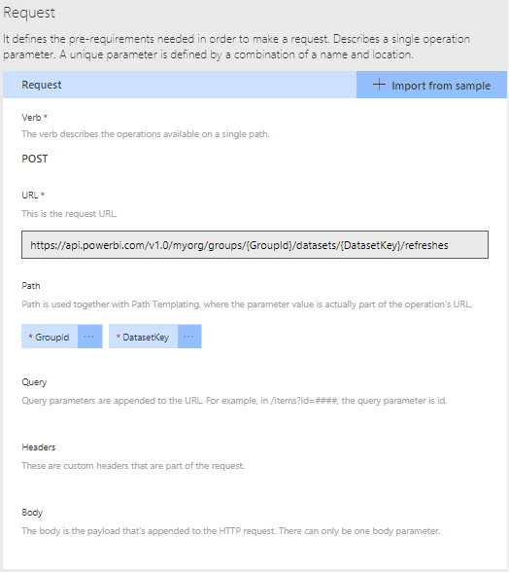
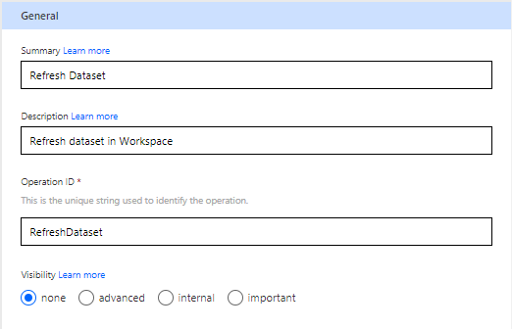
A custom connector can be built in MS Flow which triggers Power BI dataset refresh on-demand
This custom connector has 1 action defined. It can refresh the dataset inside a group workspace.
The post URL is the standard URL provided in the documentation
We have parameterized the group ID and the dataset id so that this connector can be used org-wide.

Slide 51
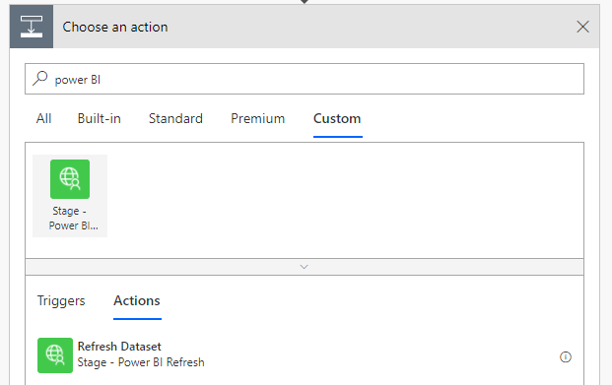
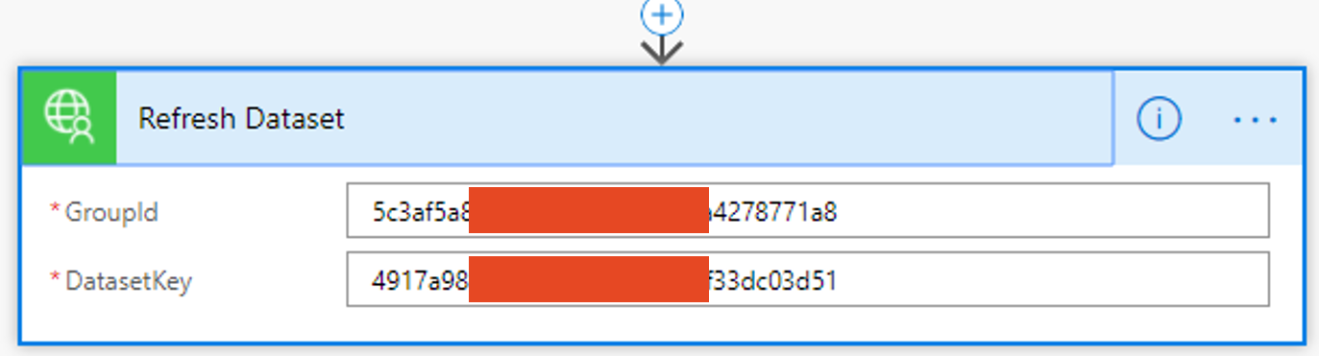
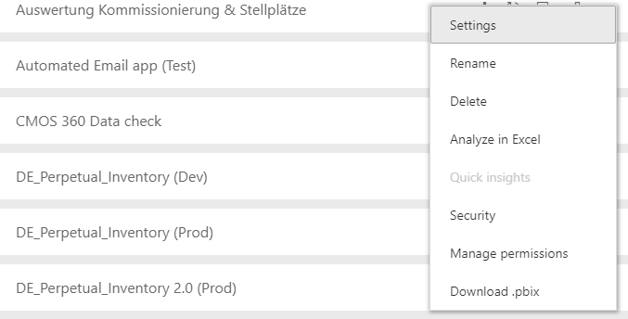
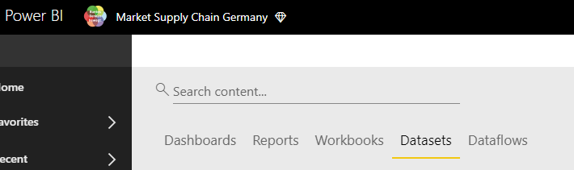
A custom connector can be built in MS Flow which triggers Power BI dataset refresh on-demand
This custom connector was already built by the CMOS Germany team and published org-wide.
Hence, the custom connector can be found if we search for ‘Stage- Power BI Refresh’ (as seen in the screenshot)
We just need to provide the group id and the dataset ID
To find the group id and dataset id
Navigate to the dataset tab in Power BI
Find the relevant dataset
Go to settings of the relevant dataset
Copy the ids from the address bar

Slide 52
7. Bug tracking and logging MS Forms + Logic App + DevOps

Slide 53
Tools Data Flow MS Flow

Slide 54


PowerApps + Logic App enables the user to pass context-aware data to trigger a series of dependent actions
Microsoft Forms is an online survey creator, part of Office 365. Released by Microsoft in June 2016, Forms allow educators to create surveys and quizzes with automatic marking. The data can be exported to Microsoft Excel.
Azure Logic Apps is a cloud service that helps you schedule, automate, and orchestrate tasks, business processes, and workflows when you need to integrate apps, data, systems, and services across enterprises or organizations. Logic Apps simplifies how you design and build scalable solutions
With Azure Boards, you can quickly and easily start tracking tasks, features, and bugs associated with your project. You do so by adding one of three work item types—epics, issues, and tasks—that the Basic process provides.

Slide 55
Tools Data Flow MS Flow

Slide 56
A Logic App can be triggered as soon as there is a modification in a SQL table
Lets assume that a dev version of a dashboard has been published. End users are testing the report both in terms of functionality and visually.
It is not intuitive to record to bugs in an excel sheet.
Ideally, it should be done in DevOps board but the end users do not have access to it
The end users fill a MS form describing the issue/problems. The user gets access to a visually appealing interface for logging the issue. Also, there is no scope for mistake as the user does not have to fill cells in an excel sheet
As soon as he submits the form, the data is captured in the form. Along with this, A logic app is also triggered which creates an issue in DevOps for the same, ready to be traced by the development team with access to the DevOps board
DevOps board becomes the central repository of all tasks, bugs and issues
** MS Forms can be used to record inputs from the end users independently as well. The responses can be exported to excel

Slide 57
Tools Data Flow Logic App

Slide 58
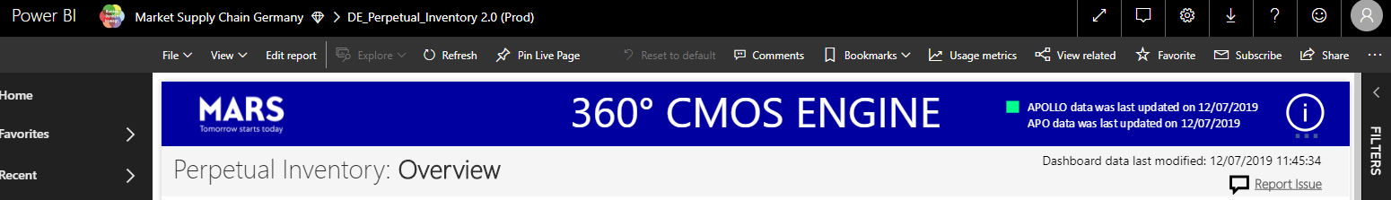
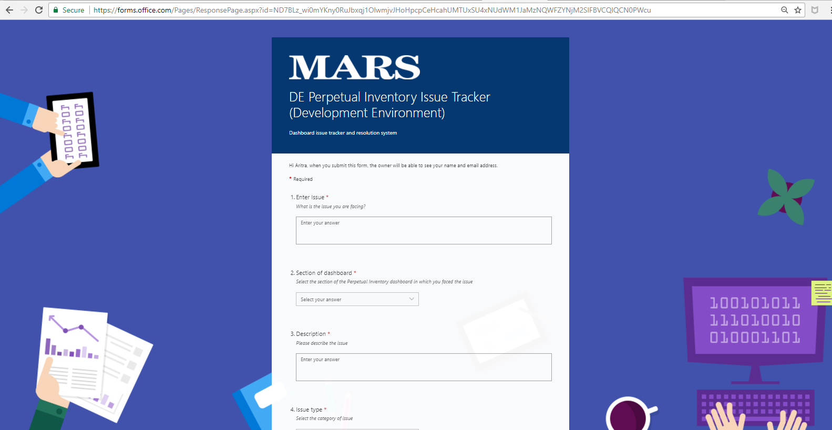
MS Forms provide a friendly interface for the end-users to provide feedback
The hyperlink to the MS Form can be given in the dashboard.
Clicking on the hyperlink redirects opens to form in a new browser tab
The form can be customized to have all relevant fields to record the responses of the end users

Slide 59
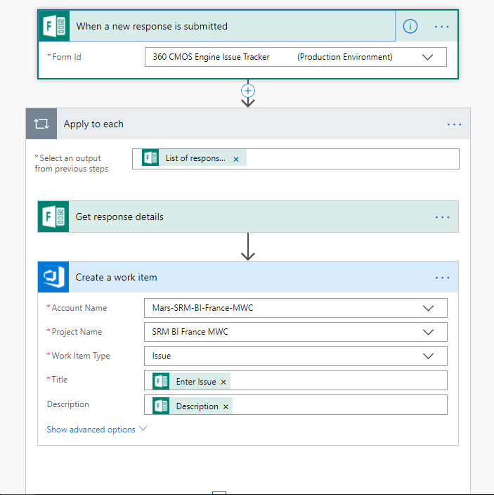
MS Forms provide a friendly interface for the end-users to provide feedback
Now the Logic App kicks into action every time a response is recorded.
As we can see, the trigger is ‘When a new response is submitted’, the Logic App is triggered. The MS form can be selected from the dropdown
Inside the ‘apply to each’ loop, for each response which is submitted, we fetch the response details as the first step.
Then we create a new work item in DevOps where we select the relevant Account name, Project name and work item type.
The title and descriptionof the issue is filled dynamically from the response of the MS Form

Slide 60
8. Azure Data Factory Pipeline trigger PowerApp/MS Teams + MS Flow

Slide 61
Tools Data Flow MS Flow

Slide 62
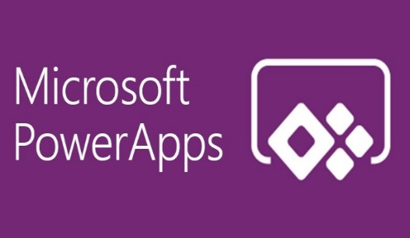

PowerApps + Logic App enables the user to pass context-aware data to trigger a series of dependent actions
PowerApps is a suite of apps, services, connectors and data platform that provides a rapid application development environment to build custom apps for business needs.
Azure Logic Apps is a cloud service that helps you schedule, automate, and orchestrate tasks, business processes, and workflows when you need to integrate apps, data, systems, and services across enterprises or organizations. Logic Apps simplifies how you design and build scalable solutions
Microsoft Teams is a unified communications platform that combines persistent workplace chat, video meetings, file storage, and application integration. The service integrates with the company's Office 365 subscription office productivity suite and features extensions that can integrate with non-Microsoft products.

Slide 63
Tools Data Flow MS Flow

Slide 64
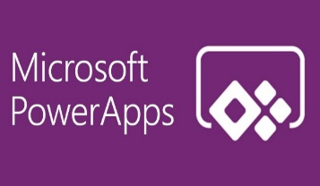
An Azure pipeline can be triggered easily by PowerApps or Teams
A pipeline is created in Azure Data Factory which carries out an end to end workflow. For example- This pipeline can copy data or trigger notebooks or trigger SQL stored procedures
The end user wants to trigger a pipeline without the help of a developer or going into the intricate interface of Azure. The user has the option of opening a PowerApp and simply pressing a button to trigger the pipeline.
The pipeline can also be triggered by the user by chatting with the MS Flow-bot from right inside teams. So the pipeline can be triggered from inside teams
The pipeline re-runs and carries out the defined action
** Teams MS Flow chat-bot can be used to list and run any MS Flow linked to the account. The end user can use this as a central control panel to trigger a combination of flows

Slide 65
Tools Data Flow Power App/Teams + Flow

Slide 66
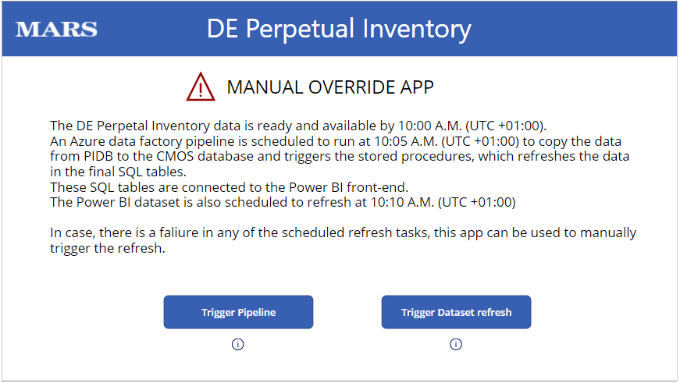
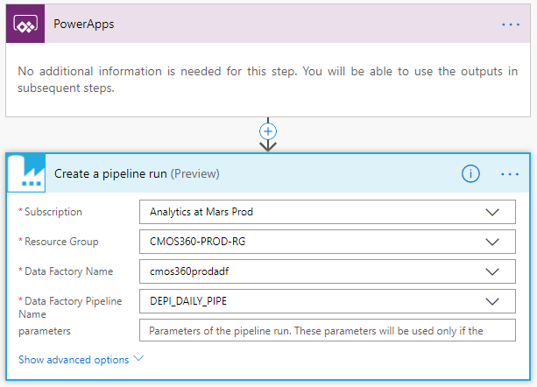
A pipeline can be triggered by a button in a Power App
A manual override PowerApp is created which contains buttons for:
Manual trigger of Pipeline
Manual trigger of Power BI dataset refresh (using the same custom connector which was previously discussed)
The press of the button triggers a MS Flow/ LogicApp
A flow is created in which the trigger is the press of the button in the PowerApp
As soon as we press the button, the action is carried out. The action definition contains the Subscription info, The RG info, the Data Factory Name, the pipeline name.
As soon as these are defined, the button can trigger the pipeline

Slide 67
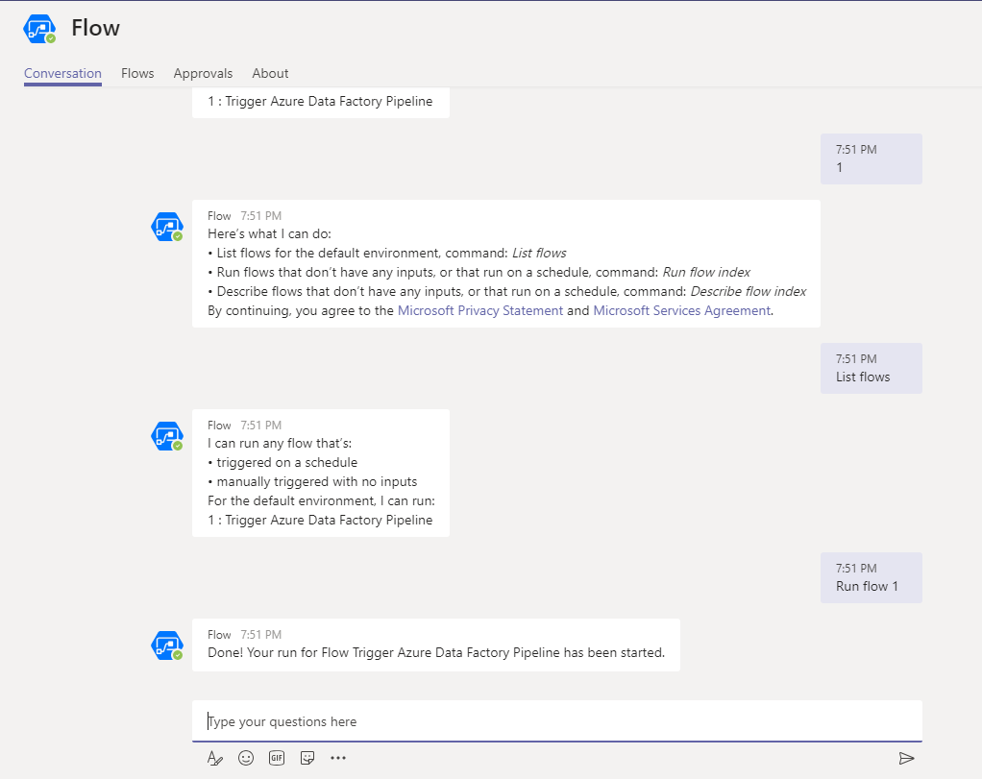
A pipeline can be triggered by the Flow chatbot inside Teams
A flow can be created (as demonstrated in previous slide), but instead of the PowerApp triggering the flow, the end user can chat with the Flow bot inside teams to trigger a flow.
All the flows are listed in the form of a index by typing ‘List Flows’.
Any flow can be triggered from here by typing ‘Run Flow 1’ or any other index number
Screenshot on the left shows a sample chat with the Flow bot

Slide 68
9. Modifying manual Mapping Tables PowerApp + SQL + Logic App

Slide 69
Tools Data Flow MS Flow

Slide 70

PowerApps + Logic App enables the user to pass context-aware data to trigger a series of dependent actions
PowerApps is a suite of apps, services, connectors and data platform that provides a rapid application development environment to build custom apps for business needs.
Azure Logic Apps is a cloud service that helps you schedule, automate, and orchestrate tasks, business processes, and workflows when you need to integrate apps, data, systems, and services across enterprises or organizations. Logic Apps simplifies how you design and build scalable solutions
Microsoft SQL Server is a relational database management system developed by Microsoft. As a database server, it is a software product with the primary function of storing and retrieving data as requested by other software applications—which may run either on the same computer or on another computer across a network

Slide 71
Tools Data Flow MS Flow

Slide 72

Rows can be inserted/deleted in SQL mapping tables via PowerApp + Logic App
A new row can be inserted by filling the fields of the PowerApp.
The data in the SQL table can be displayed inside the PowerApp in the form of galleries.
The user has the option of deleting a row from the PowerApp interface as well.
A Logic app runs to insert or delete the row from the SQL table
The modified SQL table can now be referenced as a mapping table for various other codes/processes
** The mapping table can for example be used to maintain access control for a project across segments

Slide 73
Tools Data Flow Power App+ Logic App

Slide 74
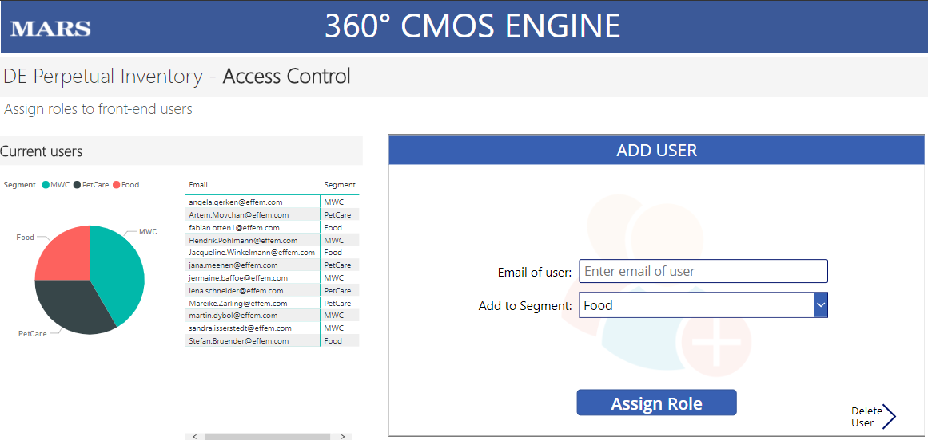
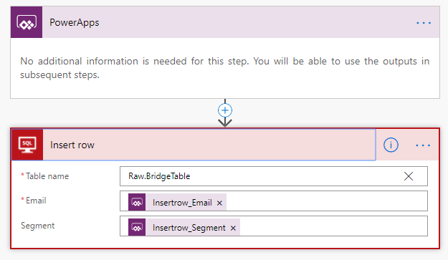
A visual interface in a PowerApp enables end users to insert new values to the mapping/reference table
The user can open a Power BI report.
The report:
Briefs the user about the current users who are added to the bridge table. This table consists of users and the respective segments they have access to. Hence, any changes they make will only affect their respective segments
The PowerApp is also embedded in the same Power BI report where users can assign roles to new users. As soon as an email is filled and a segment is selected, the user can press the submit button which will add the relevant information in the SQL table as a new row.
The Logic App is triggered at the press of the button and it picks up the information fed in the PowerApp and inserts a new row in the SQL table via the connector ‘Insert Row’.
As seen in the image, the email and the segment information is fed via variables which are assigned in PowerApp

Slide 75
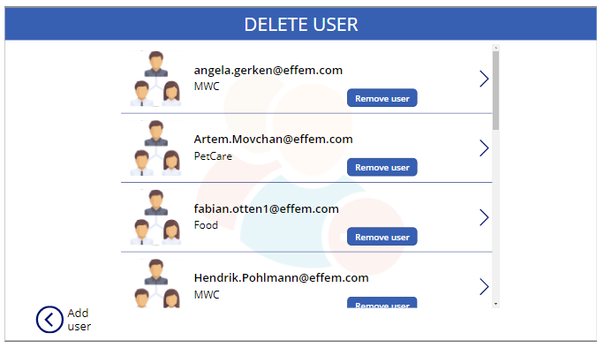
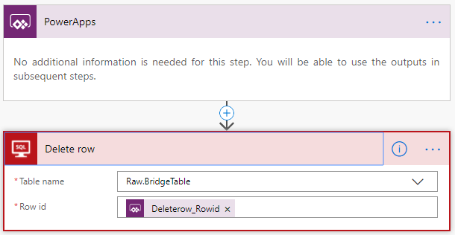
The user also has the option of viewing the users and removing a user from the front end via the PowerApp
The PowerApp displays the existing rows of the SQL mapping table in the form of a gallery.
The user can trigger a Logic App to remove access of a user
The Logic App is triggered at the press of the button and it deletes the row for which the user has pressed the delete button for.
This provides the end users a user-friendly way of making modifications to various bridge/mapping tables.
Lets say there is a mapping table which contains an attribute at an item level. So, this solution provides an elegant way for the end-users to do this

Slide 76
10. Difference between Logic App & MS Flow

Slide 77

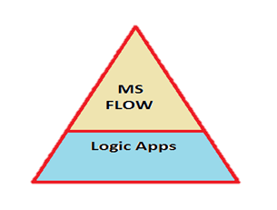
Flow vs Logic Apps- similarities and differences
First, we will see the similarities between these two. Flow and Logic Apps are both designer-first integration services that can create workflows. Both services integrate with various SaaS and enterprise applications.
Flow is built on top of Logic Apps. They share the same workflow designer and the same Connectors. So that means Flow is built on top of the Logic Apps.
Logic apps serve as the basement architecture for this serverless connectors based service. And our MS Flow has embraced that architecture and has been built over it. So we can infer that every Flow developed can be done through Logic App also. All the examples thus far we have seen in MS Flow can be developed through Logic Apps also.

Slide 78
Flow vs Logic Apps- similarities and differences
Every MS Flow is a Logic App and not every Logic App is an MS Flow!! MS Flow is something like a subset of Logic Apps.
The differences between the two are - the other building blocks of Azure family, cannot be consumed in MS Flow, for Example Azure Functions, Azure Service bus etc.
Although Logic Apps and Microsoft Flow use the same engine behind the scenes, and share the same graphical designer, this is where the similarities stop in my opinion. Each one of them have different targets in mind both from an audience and type of solution. While Microsoft Flow targets the Citizen Integrator, Logic Apps targets the Integration Developer which will be usually involved in more complex integration solutions and development practices, being part of a larger solution. Those solutions will also require richer management and monitoring controls, would benefit from a more granular and scalable payment format and could need a tighter security mechanism.

Slide 79
Flow vs Logic Apps- differences
Price Granularity
Logic Apps follow the pay-per-usage model of most of the Azure components. And it is REALLY granular. Instead of paying per logic app instance execution, you will pay for each action executed inside a logic app, and only for those actions. That means that simple logic apps workflows can be very cheap to execute, while more complex logic apps can be more expensive. It also means that since you don’t have an execution cap as in Microsoft Flow, you can break down your Logic Apps into smaller reusable components.
Development Experience
Logic Apps supports both a browser base development experience – using the Logic Apps designer within the Azure Portal – and a IDE based development experience, using Visual Studio. Users can import Logic Apps developed in the portal into Visual Studio and include it into an Azure Resource Group project, opening the possibilities of using a source control to keep track of logic apps changes and build and deployment automation both in isolation or within the context of a larger solution. Developers are not restricted to a single environment, but can deploy the Logic Apps in any environment that they have permission to.

Slide 80
Flow vs Logic Apps- differences
Full Control over code
Logic Apps design tool allow users to switch between visual design and a code view, based on a workflow definition language that is specific to Logic Apps. This allows developers to have more control over the code being implemented, including more control over build/deployment automation, using environment variables.
Rich Management/Monitoring Experience
Being created with enterprise clients in mind, Logic Apps have more options for management and monitoring. Using the Azure Portal as its backbone, Logic Apps management allow sys admins and operators to see at a glance the latest executions of an instance of a logic app, providing search capabilities to find executions by date range and status. It also allows a previous execution to be resubmitted directly from the portal and allow the creation of alerts based on a number of monitoring metrics, like percentage of failed executions in a period of time.

Slide 81
Flow vs Logic Apps- what to choose?
Choosing Between Microsoft Flow and Logic Apps
Using Microsoft Flow
The scenarios below are classic scenarios that would fit Microsoft Flow:
I don’t have access to an Azure subscription but still need to implement workflows to improve my own or the organization integration
I need to implement personal workflows that improves my own productivity, with or without access to a Dynamics or Office 365 account.
I need to implement Power Apps applications – Power Apps and Microsoft Flow have a tight integration and work quite well together.
I am working on an organization that have Dynamics or Office 365 active subscription and:
Have a need to create workflows to integrate first party applications Office and Dynamic 365 applications, including single button applications, approval applications.
Have a non-developer background but need to implement organizational workflows to support my activities.
My workflows are not part of a EAI solution needs to be implemented, deployed and versioned as a single ARM template.
My management/monitoring requirements are simpler, not requiring data aggregation.
Using Logic Apps
The scenarios below are cases where Logic Apps would be a better fit:
I am implementing integration workflows that are part of a larger solutions which involves multiple Azure resources, needs to be source controlled, versioned and deployed via ARM templates as a single unit within Azure.
I require more control over my workflow development, either because some of my actions are more complex, which benefit from writing them directly in code, or because I would need parametrization across multiple environments
I need close to real time (under a minute) logic app triggering on a connector that uses polling as the firing mechanism.
I need an aggregated view of my logic apps execution from a monitoring point of view.
I need a more control over access to my workflows across different roles in my organization.
I am implementing B2B applications that need to leverage from EDI, XML validation and transformations.

Slide 82
Flow vs Logic Apps- summary
Microsoft Flow and Logic Apps belongs to the same family of products – I usually joke that Microsoft Flow is the younger brother of Logic Apps (or, since I am surrounded by Pokemon toys and games at home, Logic Apps is the evolved form of Microsoft Flow).
Non-developers, especially those without an Azure subscription or with access to a Dynamics of Office 365 subscription, will benefit from having a workflow engine to implement solutions that can improve productivity both on personal and organization levels at no extra cost.
Both are quite powerful having different sweet spots and audiences. There are cases where Logic Apps might be better suited than Microsoft Flow, but in most of the cases it is more a business decision about integration strategy. Since they share the same underlying engine Microsoft Flow can be easily transformed into a Logic App, which makes migration / consolidation in cases of change in strategy simpler.

Slide 83
Thank you.
17 July 2019

